Slide 1
House Control
Alperen KAYA
2016514043
Programming Languages

Slide 2
AIM OF THE PROGRAM
This Project builded for lecture work and the Project is an house control application with arduino and C#.
This program is designed for worker women and men, to control their house.
For this process, they have to connect the device to the house.

Slide 3
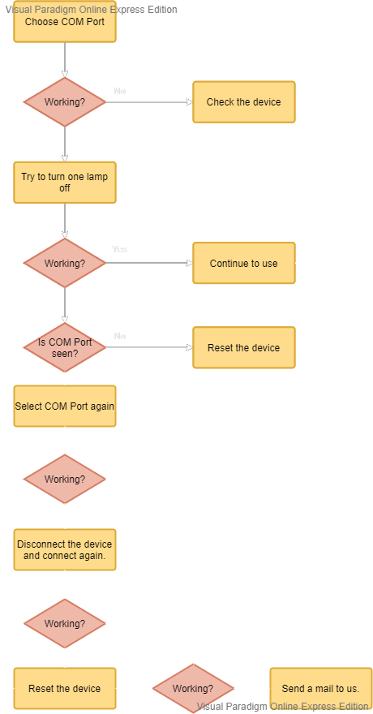
How to work?

Slide 4
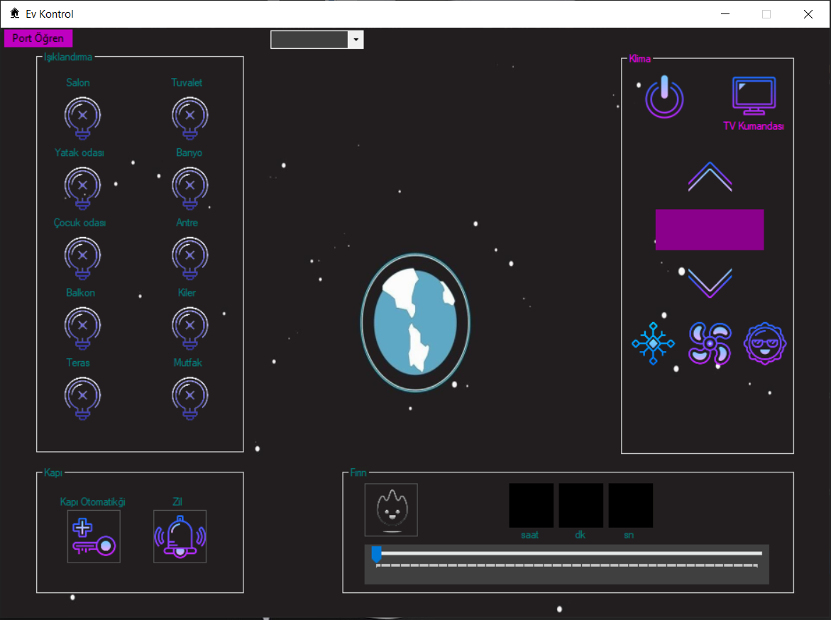
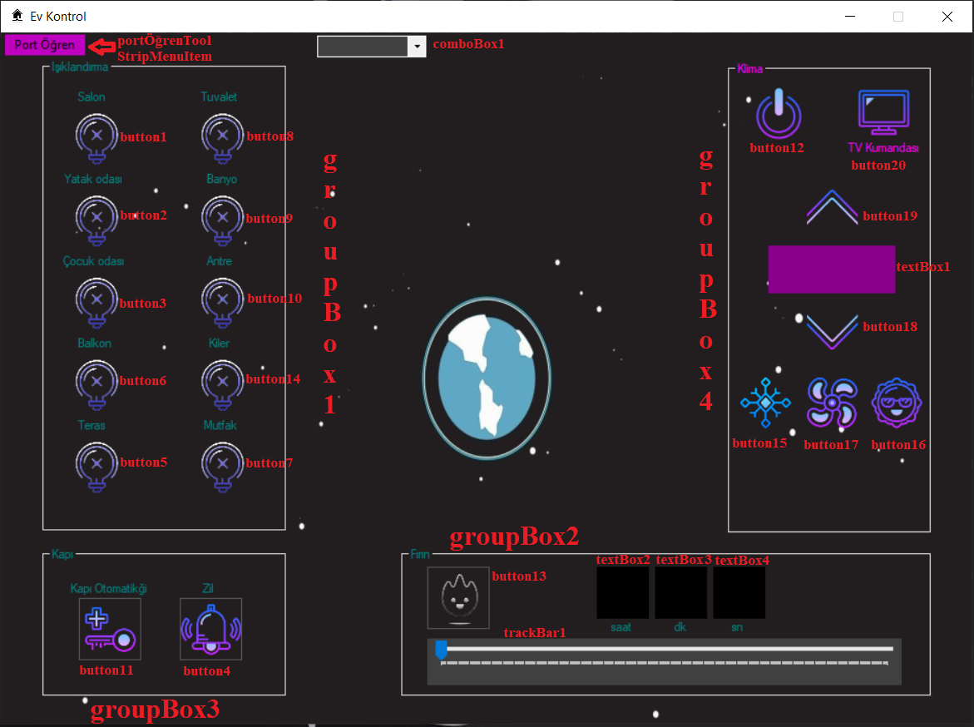
MAIN SCREEN OF THE PROGRAM

Slide 5
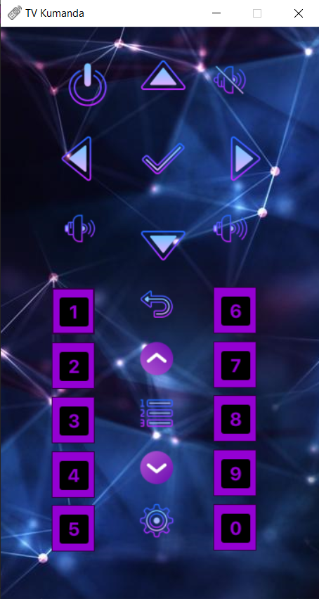
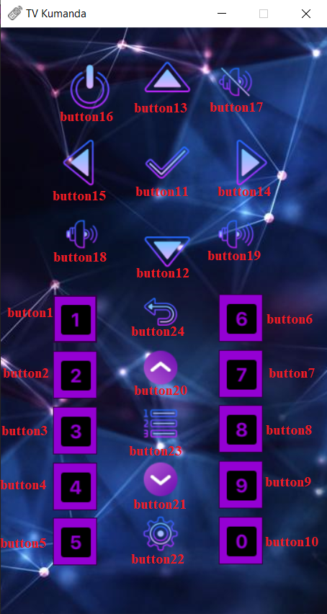
FORM2: TV REMOTE CONTROL SCREEN

Slide 6
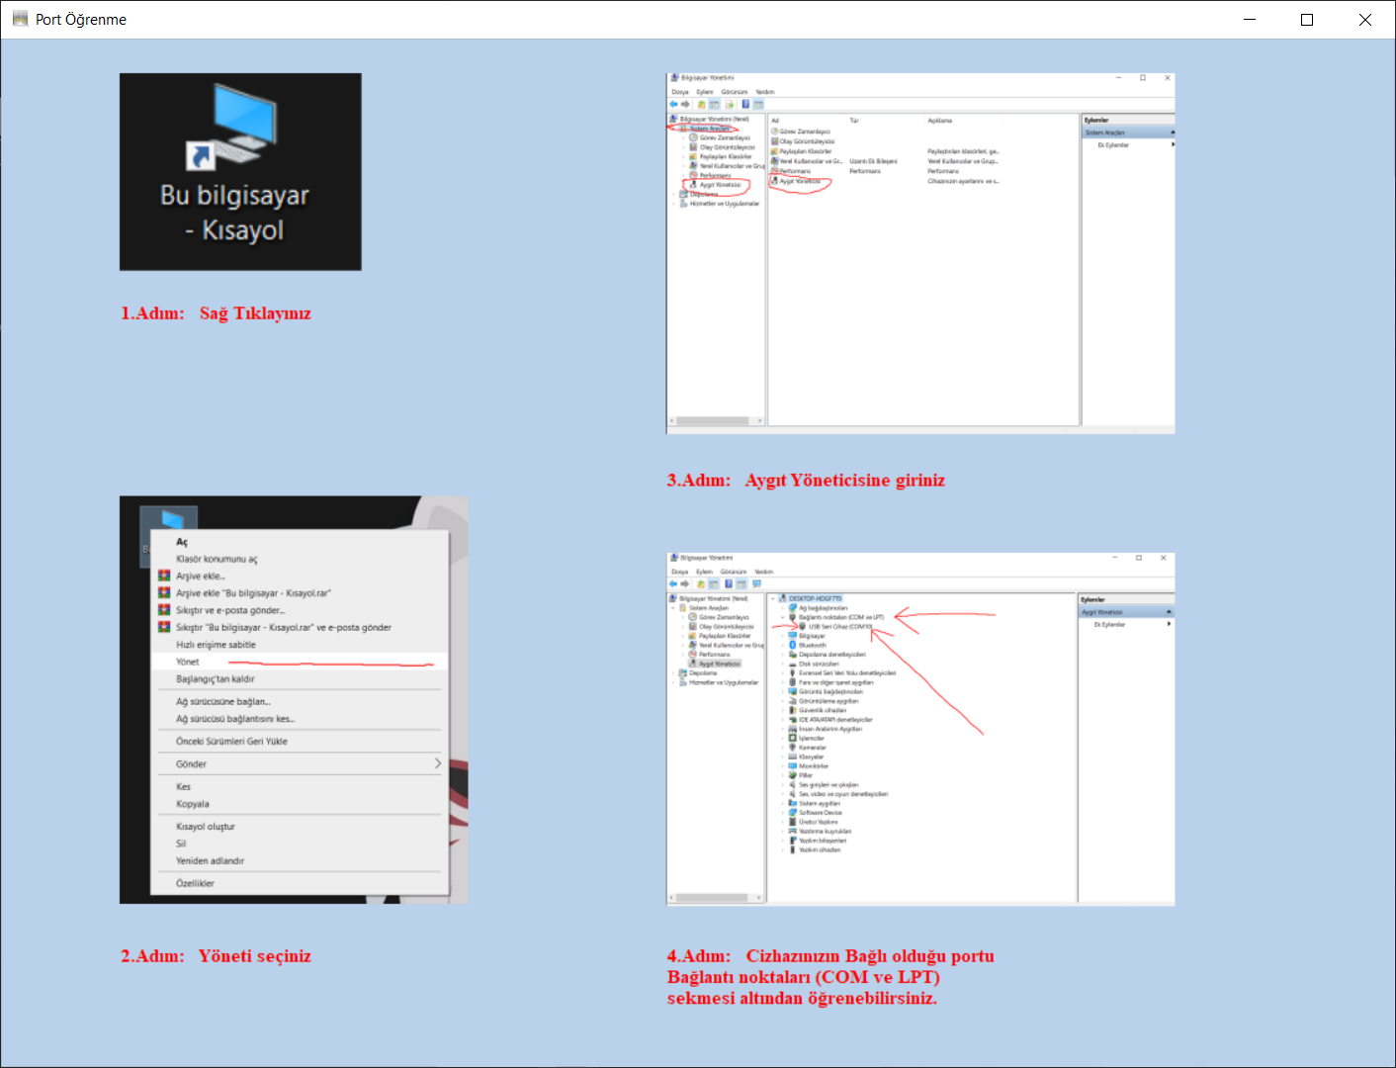
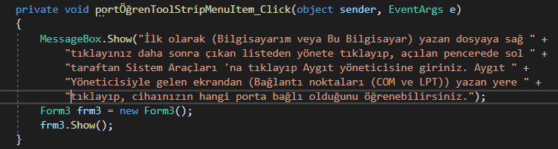
FORM3: PORT FINDING GUIDE SCREEN

Slide 7
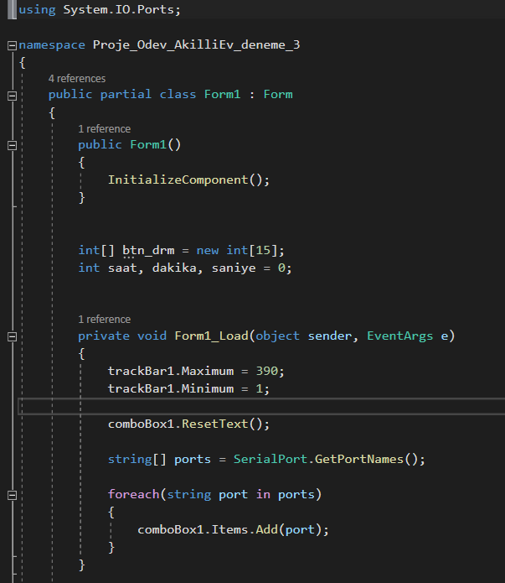
ESTABLISHING THE FOUNDATION OF THE PROJECT
Serial Port and some variables declaration
Btn_drm array is used to change the image indexes and declear button states to device.
I set the time limit maximum 6.5 hours.
390 / 60 = 6.5

Slide 8
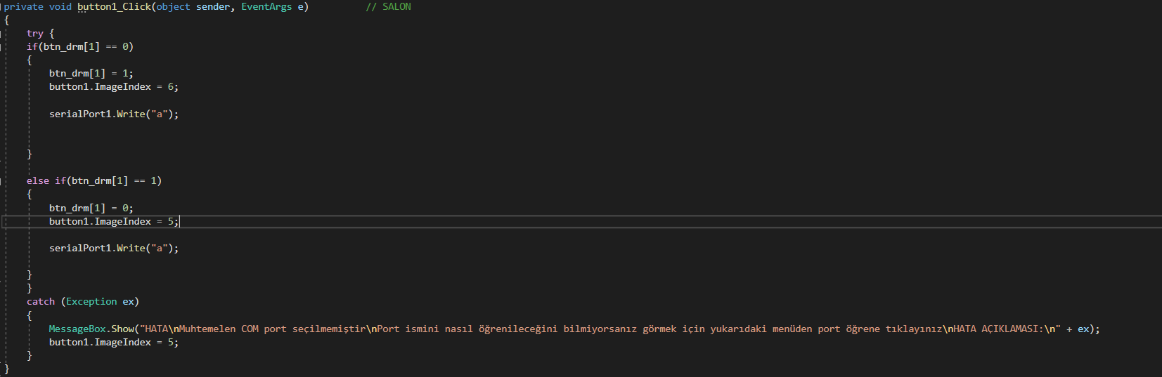
AN EXAMPLE CODE FOR BUTTONS

Slide 9
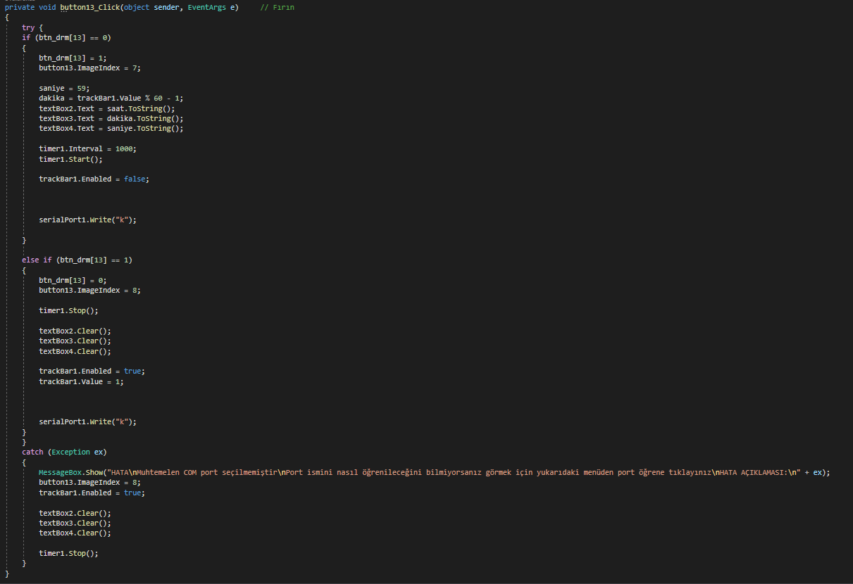
CODE OF button13 BUTTON

Slide 10
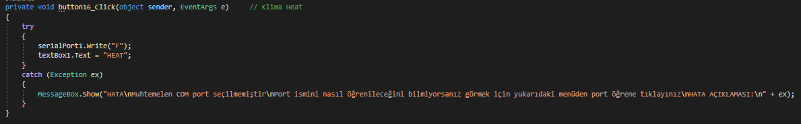
CODE OF button16 BUTTON
When the user click on the sun image on the air conditioner remote it will write HEAT on textBox1 and the pc send F on serial comminication to arduino then arduino send a data package on its pin3 to the IR-led through BC547 transistor.

Slide 11
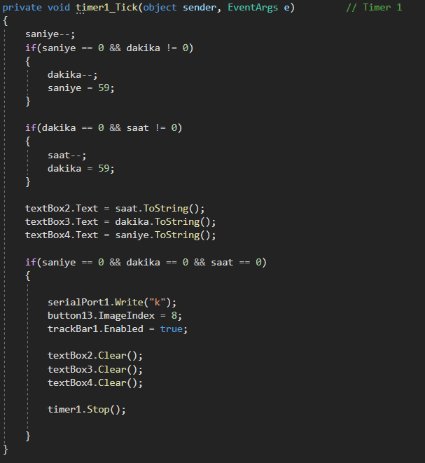
CODE OF TIMER TICK
Some decleraition for timer.

Slide 12
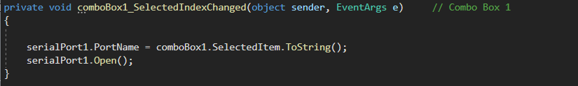
COM PORT SELECTION AND STARTING THE COMMUNICATION
The selected port is used to comminication with the device (arduino).

Slide 13
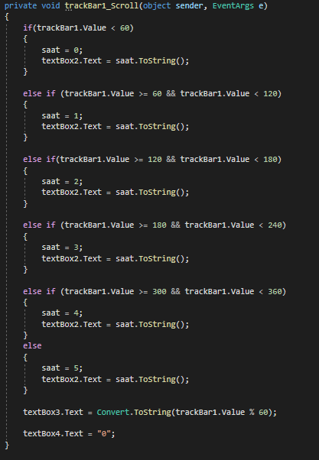
CODE OF trackBar1
Track bar is used to set OFF time for oven.

Slide 14
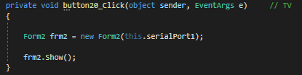
CODE OF button20
It opens the Form2.
this.serialport1 transfer the datas of serial communication to Form2. So the user do not need to select again a new COM port.

Slide 15
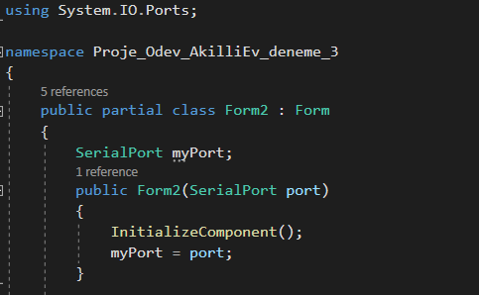
INITIALIZATION THE FOUNDATION OF THE PROJECT
Transfering the serial communication
setting information to myPort variable.

Slide 16
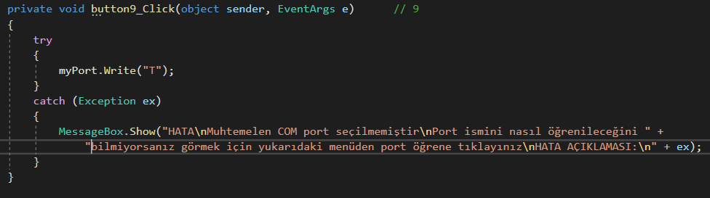
AN EXAMPLE CODE FOR BUTTONS IN FORM2
This is the NUM-9 button of TV remote controller. When user click on the Num-9 button the app will sent a data to arduino and the arduino will sent a data package to IR-led throught BC547 transistor.

Slide 17
ARDUINO PARTS
X12 5V coil Relays
X2 BC547 NPN Transistors
X1 IR-LED
X1 Arduino UNO (ATMEGA 328P)
X1 5V power supply
IRremote_-master library (external lib.)

Slide 18
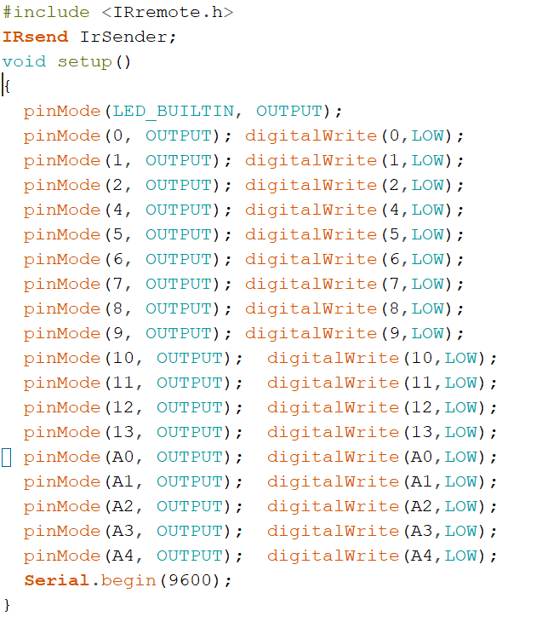
ARDUINO CODES
Setup
&
Declearing library for IR-remotes.

Slide 19
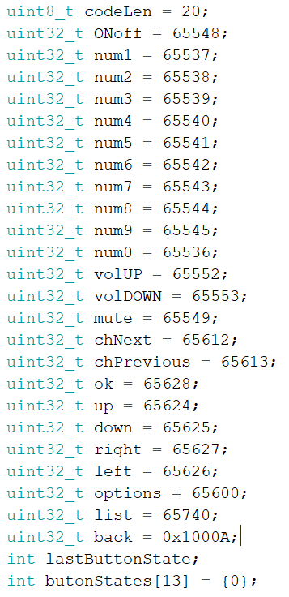
ARDUINO CODES
Initialization of remote’s variables.
These all variables are for my own devices.

Slide 20
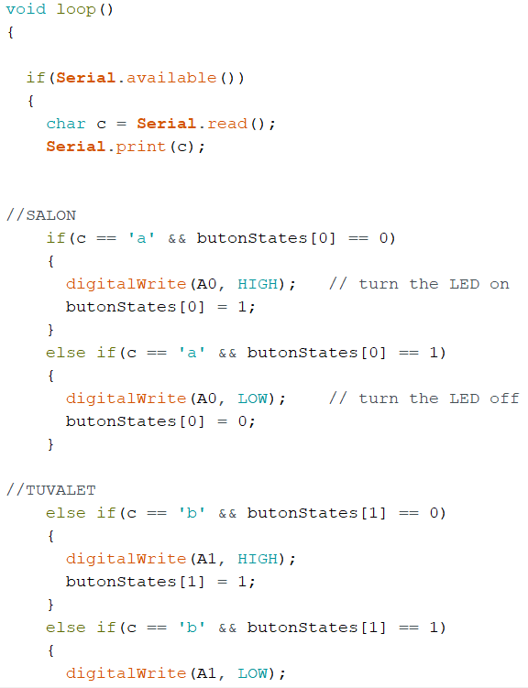
ARDUINO CODES
Void loop and sending data codes examples.

Slide 21
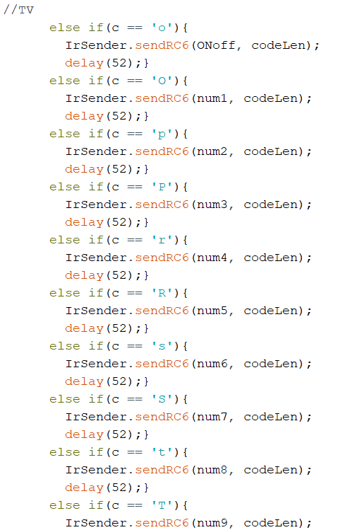
ARDUINO CODES
TV remote sending data codes examples.

Slide 22
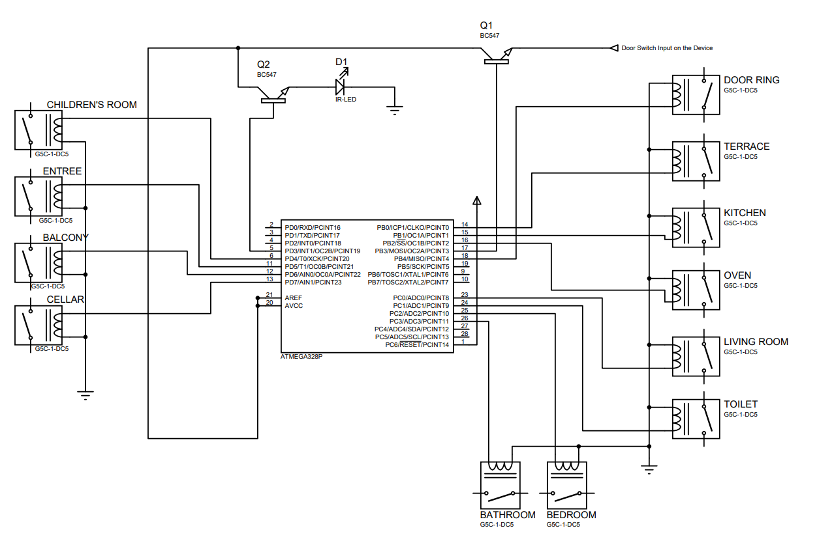
ARDUINO PART

Slide 23
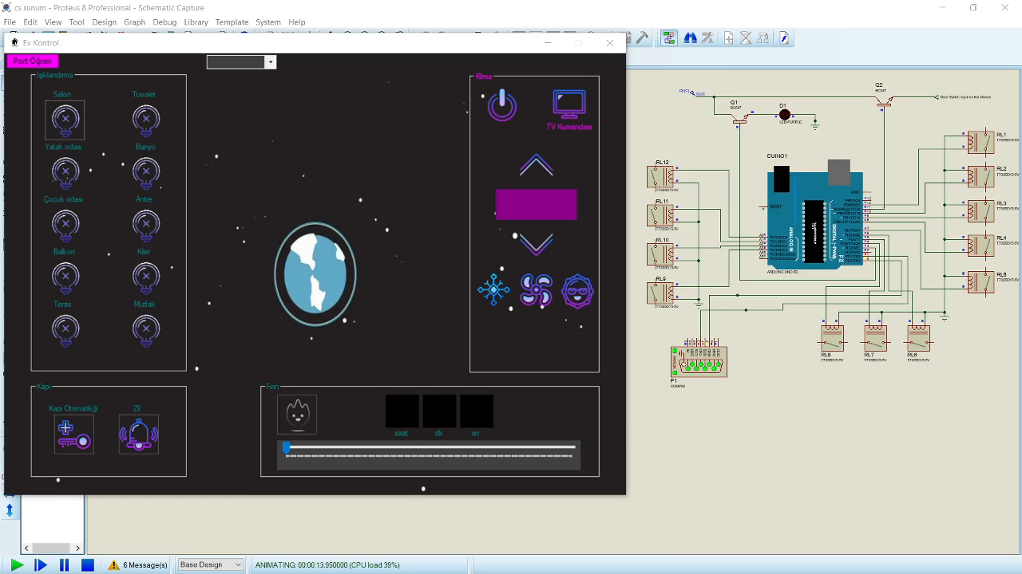
PPROJECT SIMULATION
The remote controllers are working but it can’t be simulated on this simulation app because the library of IR controller is not declarated in simulator. And it does not support upload.
But I did proof it’s working in the class.

Slide 24
THANKS FOR YOUR TIME TO ME

